Slide 1
My First Role
My First Role
Evolving from giant playbooks to roles

Slide 2
$whoami
Fredrik Lindqvist
Network tech in the public sector
Linux and Tech enthusiast since “forever”
Matrix @landrash:matrix.hibble.se
Github github.com/landrash

Slide 3
My Ansible History
A problem that need to be solved.
A network established with a time crunch.
Distributed documentation for IP addresses and VLAN’s established was incorrect and needed to be corrected.
My solution was Ansible since I had already used it for templating configurations and I knew it could do so much more.

Slide 4
What I started with
Playbooks with 2000+ lines
Group var files with 100+ lines
Hard to maintain code
A quickly growing technical debt

Slide 5
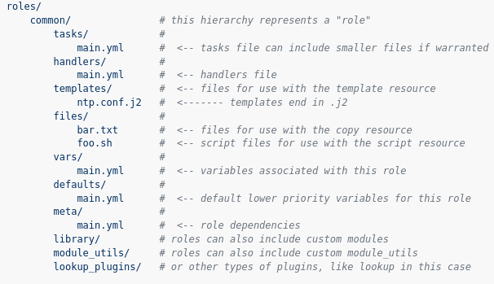
What is a role?
Roles let you automatically load variables, files and more
Based on the same structure as the rest of Ansible
Can be executed as roles or included in a playbook
Tags can be used to run only certain parts of a role

Slide 6
Tools and Documentation
Everything you need
docs.ansible.com
Ansible-lint
ansible-lint.readthedocs.io
Inspiration from geerlingguy’s roles on Github

Slide 7
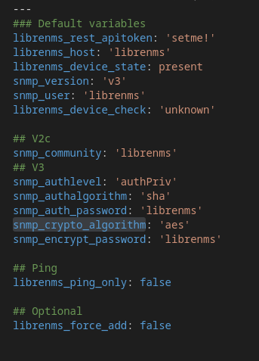
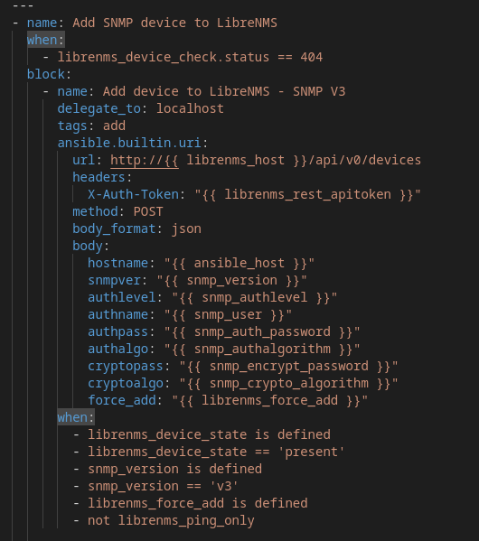
First steps towards my first role
Separating out variables that can be reused
Separating out tasks and logic
Simplifying logic
Simplifying tasks where possible

Slide 8
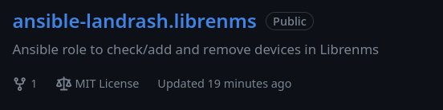
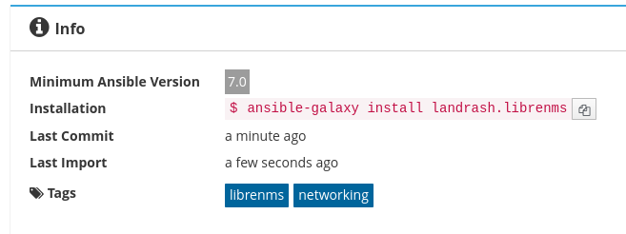
Going public
Whats the point of open source if you don’t contribute
Published on Github
Published on Ansible Galaxy

Slide 9
Was it worth It
With this simple role
  100 Lines of code less in each playbook with these tasks
  10 less variables per system
Better and cleaner code
Less technical debt with reusable code
Learned more about Ansible
In short, YES!

